Slide 1

ITECH 1502 Final Project Presentation Title: Phishing Emails in Action Student Name: Shafiullah Anik Student ID: 30454295 Platform: Tryhackme

Slide 2
Project Overview
Goal: To understand and analyze real-world phishing techniques.
Platform Used: TryHackMe – Phishing Emails in Action lab.
Tasks Completed: 8 tasks covering PayPal, Netflix, Apple, and DHL phishing emails.
Outcome: Enhanced skills in identifying, analyzing, and mitigating phishing threats.

Slide 3
Methodology and Setup
Environment: TryHackMe AttackBox (Ubuntu 20.04).
Tools Used:
Email Header Viewer
Browser Developer Tools
URL Expander
Any.Run sandbox for malware analysis
Process: Step-by-step email investigation and evidence collection.

Slide 4
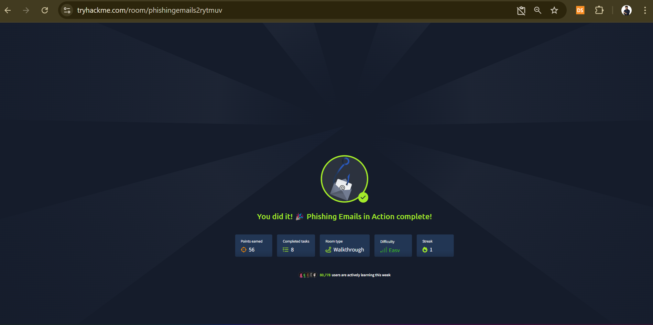
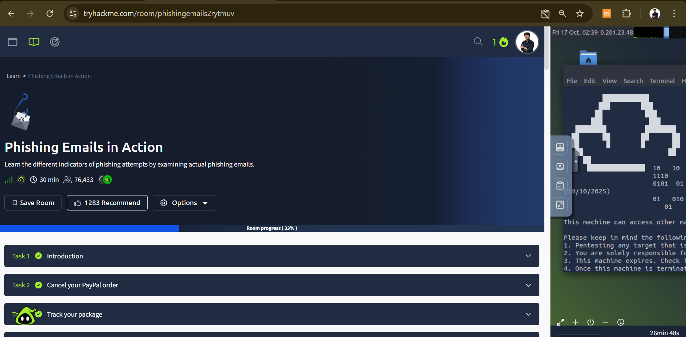
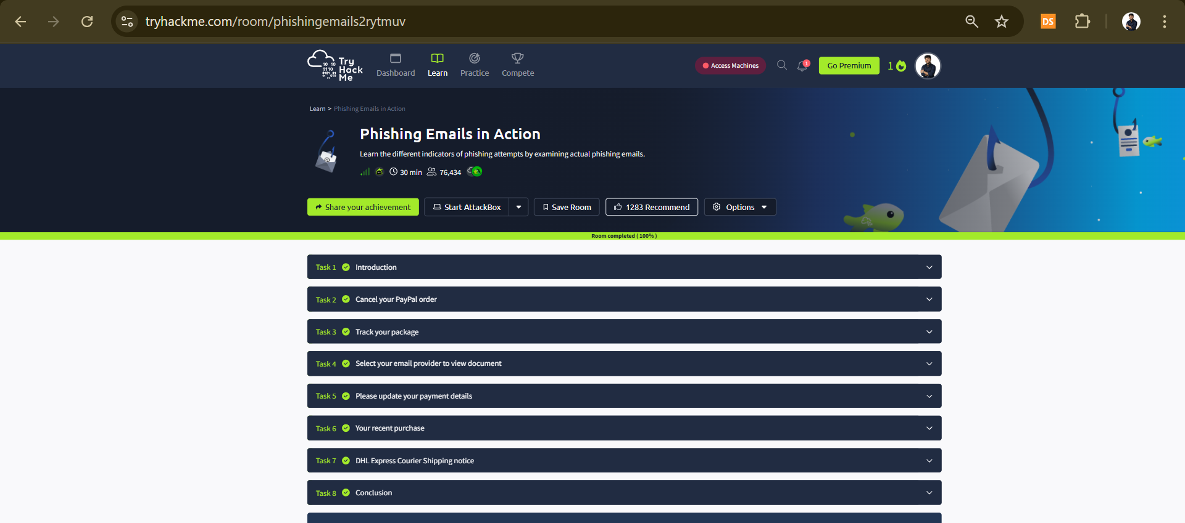
Hands-On Evidence

Slide 5
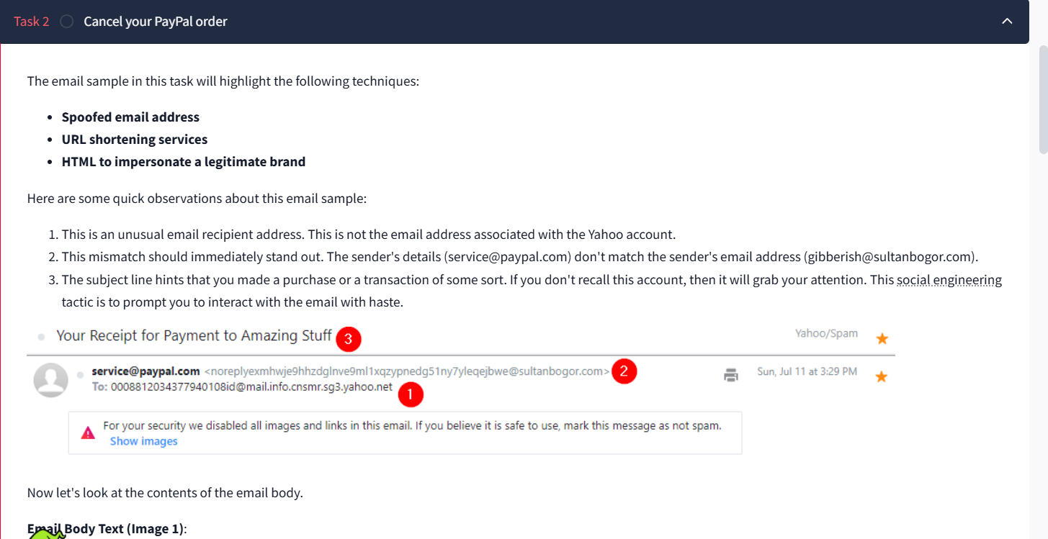
Technique: Spoofed sender and URL shortening.
Fake Sender: service@paypal.com (real: @sultanbogor.com).
Phishing Trick: Urgent ‘Cancel Order’ button with shortened link is.gd/6oCJ4m.
Case Study 1: PayPal Phishing Email

Slide 6
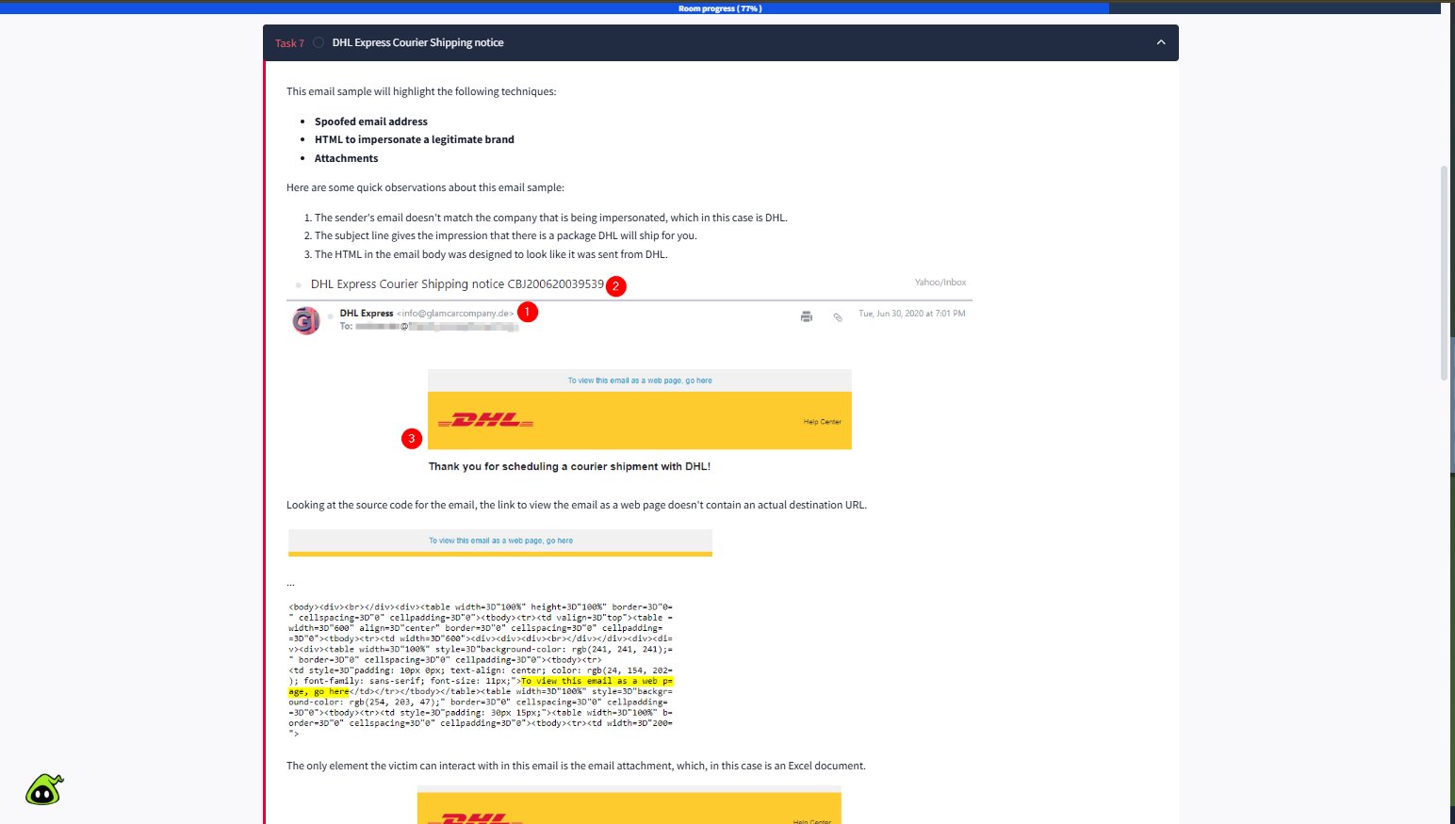
Case Study 2: DHL Fake Shipping Notice
Sender: info@glamcarcompany.de (fake DHL address).
Attachment: Excel file CBJ200620039539.xlsx.
Malware Executable: regasms.exe.
Technique: Attachment-based macro malware.
6

Slide 7
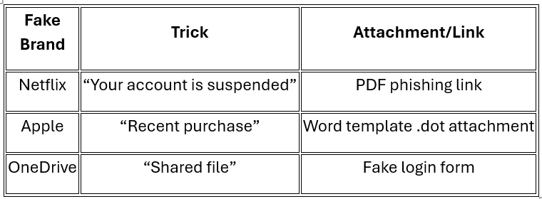
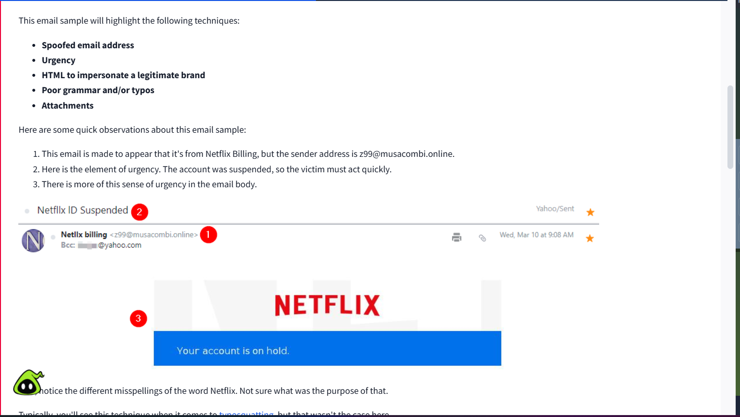
Case Study 3: Netflix and Apple Email Scams
7

Slide 8
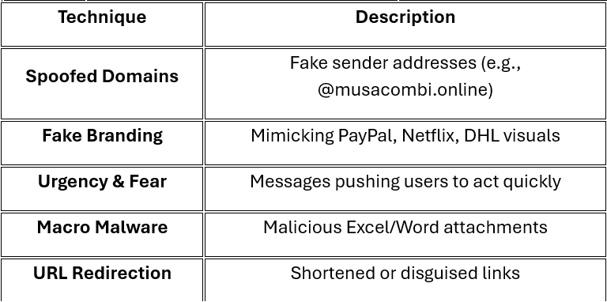
Key Findings
8

Slide 9
Reflection and Learning Outcomes
Strengthened ability to identify phishing patterns.
Learned to analyze URLs, domains, and attachments.
Understood how malware executes from macros.
Gained practical cybersecurity analysis experience.

Slide 10
Thank you

